Slide 1

Natural Language Processing
Recitation Class

Slide 2
Recap
Language Model: A system that predicts the next word
Recurrent Neural Network: A family of neural networks that:
Take sequential input of any length
Apply the same weights on each step.
Can optionally produce output on each step
Problems: Vanishing and exploding gradient
LSTM: Solution of Vanishing gradient
Gradient Clipping: Solution for Exploiding gradient
GRUs are similar to Long Short-Term Memory (LSTM)
Machine Translation
Seq Seq Neural machine translaton

Slide 3
So, is Machine Translation solved?
The bottleneck problem arises from the fixed-size representation of the source sentence. If the source sentence is very long or contains complex information, it's challenging for the encoder to compress all the relevant information into this fixed-size vector. As a result, some information may be lost or not adequately represented in the context vector.

Slide 4

Solution to Bottleneck problem?
Attention provides a solution to the bottleneck problem. • Core idea: on each step of the decoder, use direct connection to the encoder to focus on a particular part of the source sequence

Slide 5
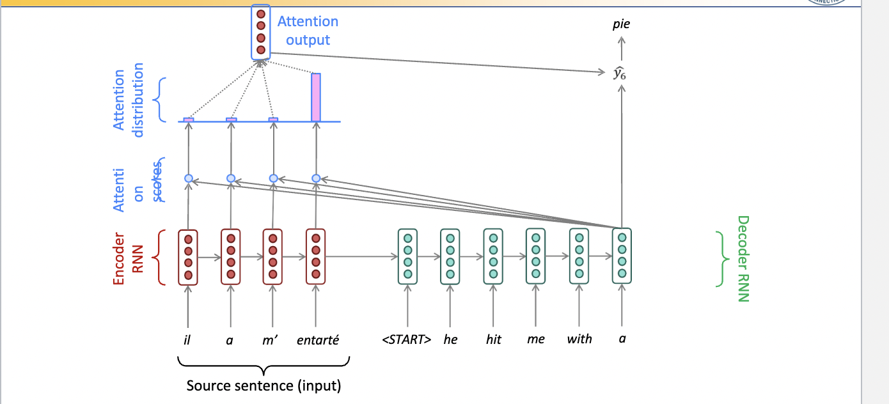
Seq to seq with Attention

Slide 6
Attention
Attention mechanisms in machine learning are used for focusing on specific parts of input data when making predictions or generating outputs.
Attention allows the model to consider the context and relevant information from the entire input sequence, assigning different weights to different elements based on their relevance to the current step in the output generation process.
Attention refers to a mechanism in which a model calculates attention scores between different parts of an input and another part of the input or external memory. For example, in machine translation, the attention mechanism calculates attention scores between the source sentence and the target sentence, allowing the model to weigh the importance of each part of the source sentence in the target translation.

Slide 7
Self- Attention
Self-attention is a specific type of attention mechanism where the input sequence is the same as the output sequence.
It is a mechanism that allows elements within the same sequence to attend to each other, considering the relationships and dependencies between elements within that sequence.
On the other hand, self-attention is a mechanism by which the model calculates attention scores between different parts of the input sequence without using external memory. Self-attention lets the model figure out how important each part of the series is, determine how the parts depend on each other and make predictions based on that.

Slide 8
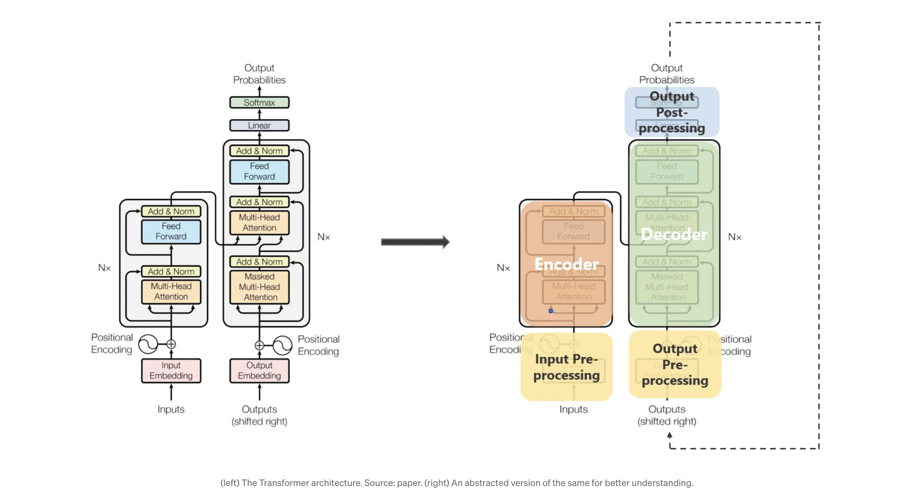

Slide 9
Key components and features of the transformer architecture:
Attention Mechanism:
The attention mechanism allows the model to focus on different parts of the input sequence when making predictions. It captures relationships between words by assigning different weights to different parts of the sequence.
Encoder-Decoder Structure:
The transformer architecture is composed of an encoder and a decoder. In NLP tasks, the encoder processes the input sequence, and the decoder generates the output sequence.
Self-Attention:
Self-attention allows each word in the input sequence to attend to all other words. This enables the model to capture dependencies and relationships between words regardless of their positions in the sequence.
Multi-Head Attention:
To capture different types of relationships and patterns, transformers use multiple attention heads in parallel. Each head focuses on different aspects of the input sequence.
Positional Encoding:
Since transformers don't inherently understand the order of the input sequence, positional encodings are added to provide information about the positions of words in the sequence.

Slide 10
Pretraining
In Natural Language Processing (NLP), pretraining involves training a model on a large corpus of text data to learn general language representations. Pretraining in NLP typically uses unsupervised or self-supervised learning techniques to train models like BERT (Bidirectional Encoder Representations from Transformers), GPT (Generative Pretrained Transformer), and their variants.

Slide 11
Here's a breakdown of pretraining in NLP:
Unlabeled Text Corpus: Large amounts of text data, often scraped from the internet or aggregated from various sources, serve as the training corpus. This corpus contains diverse language patterns, styles, and topics.
Pretraining Tasks:
Masked Language Modeling (MLM): The model is trained to predict masked words within sentences. It learns to understand context by predicting missing or masked words in a sentence.
Next Sentence Prediction (NSP): Models like BERT also include the NSP task, where the model predicts whether two sentences appear consecutively in the original text or not. This helps the model understand relationships between sentences.

Slide 12
Continuation:
3. Transformers and Self-Attention: Many pretraining models in NLP are based on transformer architectures, which leverage self-attention mechanisms to capture dependencies between words in a sentence more effectively.
4. Learning Rich Representations: During pretraining, the model learns rich, contextual, and hierarchical representations of words, phrases, and sentences. It captures nuanced language patterns and semantics.
5. Transfer Learning: Once pretrained on a vast amount of text, these models can be fine-tuned on smaller, labeled datasets for specific downstream tasks like sentiment analysis, question answering, or text classification. This transfer learning step uses the general language understanding acquired during pretraining to adapt to the specific task.

Slide 13
Pretraining for three types of architecture
Decoders (Language Models):
Use Cases: Ideal for text generation tasks, but can't condition on future words.
Examples: GPT-2, GPT-3, LaMDA.
Pretraining Focus: Language models like GPT series focus on autoregressive language modeling, predicting the next word based on preceding words, enabling coherent and contextually relevant text generation.

Slide 14
Eg: Pretraining Decoder
GPT-2, involves training the model to predict the next word in a sequence based on the context of preceding words. Here's an example of how this pretraining process might work:
Objective: Predict the next word in a sentence.
Training Data: Consider a sentence from a large corpus of text, for instance:
"The cat sat on the ____."

Slide 15
Pretraining Process:
Tokenization: The sentence is tokenized into individual words or subword units. Each token is assigned a unique ID in the vocabulary.
Training Task: The model is presented with the sentence up to a certain point and trained to predict the next word.
Contextual Learning: The model learns to understand the context of the sentence by analyzing the words preceding the blank space.
Training Objective: The model aims to maximize the likelihood of predicting the correct next word given the context provided.
Loss Computation: During training, the difference between the predicted word probability distribution and the actual next word is calculated as a loss. The model adjusts its parameters to minimize this loss.

Slide 16
Example:
Given the sentence "The cat sat on the ____," the model is expected to predict the next word, which might be "mat," "floor," or "chair," based on its learned understanding of language patterns and context.
Iterations and Generalization:
The model is exposed to numerous sentences and sequences during pretraining, learning from diverse language patterns, semantics, and contexts present in the training corpus. As it trains, the model generalizes its understanding of language structure, allowing it to generate coherent and contextually relevant text during inference or fine-tuning for specific tasks.

Slide 17
Evaluation:
The model's performance is evaluated based on its ability to accurately predict the next word in unseen or validation sentences. Higher accuracy and lower loss indicate a better understanding of language patterns.
Conclusion:
This iterative process of training the decoder model on large text corpora, predicting subsequent words given preceding context, and optimizing its parameters forms the core of pretraining a decoder for tasks like language modeling and text generation.

Slide 18
2. Encoders (Bidirectional Context):
Use Cases: Provide bidirectional context, capable of conditioning on future words.
Examples: BERT and its variants like RoBERTa.
Pretraining Approach: Encoders like BERT capture bidirectional context through tasks like masked language modeling, understanding relationships between words in both directions.

Slide 19
Eg: Pretraining Encoders
BERT, involves capturing bidirectional context and understanding relationships between words. Here's an example illustrating the pretraining process for an encoder:
Objective: Understand bidirectional context and relationships between words.
Training Data: Consider the sentence: "The cat sat on the ____."

Slide 20
Pretraining Process:
Tokenization: The sentence is tokenized into individual words or subword units, and each token is assigned a unique numerical representation.
Training Task: The model is presented with the sentence and trained to understand the relationships between words in both directions (left and right contexts).
Masked Language Modeling (MLM): In BERT-style pretraining, certain words in the sentence are masked (replaced with a special [MASK] token), and the model is tasked with predicting these masked words based on the surrounding context.
Contextual Understanding: The model learns to capture bidirectional dependencies by analyzing the words before and after the masked token(s).
Training Objective: The model's goal is to predict the original masked word(s) accurately. It encodes contextual information to make accurate predictions.

Slide 21
Example Prediction:
Given the sentence "The cat sat on the ____," and suppose the word "mat" is masked, the model aims to predict the masked word based on the context provided by words "The," "cat," "sat," and "on."
Iterations and Learning:
The model is trained on a vast corpus of text data, exposed to diverse sentence structures and language patterns. It iteratively learns to capture relationships between words in both directions

Slide 22
Evaluation:
The model's performance is evaluated based on its accuracy in predicting masked words in unseen or validation sentences. Higher accuracy indicates a better understanding of bidirectional context and relationships between words.
Conclusion:
Pretraining an encoder, such as BERT, involves understanding bidirectional context through tasks like masked language modeling. This enables the model to capture intricate language relationships and context, forming a strong foundation for downstream tasks such as text classification, named entity recognition, and question answering during fine-tuning.

Slide 23
3. Encoder-Decoders (Hybrid Approach):
Use Cases: Incorporate the strengths of both encoders and decoders.
Examples: Models like Transformer, T5, Meena.
Pretraining Strategy: These architectures leverage bidirectional context while also enabling text generation and conditioning on future words, aiming to amalgamate the benefits of both encoder and decoder architectures.

Slide 24
Eg: Pretraining Encoder-Decoders
Pretraining an encoder and decoder individually, similar to the components within a Transformer architecture, involves training both components separately with specific tasks. Let's break down the pretraining process for an encoder and decoder using tasks akin to the Transformer model:
Objective: Capture bidirectional context (encoder) and facilitate generation (decoder).
Training Data: Consider pairs of sequences, such as source-target sentence pairs for machine translation.

Slide 25
Pretraining Process
Encoder Pretraining (Similar to BERT):
Task: Train the encoder to capture bidirectional context and relationships between words in the source sequences.
Method: Utilize a masked language modeling task, similar to BERT.
Example: Given a source sentence, mask certain words and train the encoder to predict the masked words based on the context of the sentence.
Decoder Pretraining (Similar to GPT):
Task: Train the decoder to generate sequences and predict the next word in a sequence based on the preceding context.
Method: Autoregressive language modeling task, similar to GPT.
Example: Given a target sentence, train the decoder to predict the next word in the sequence based on the words preceding it.

Slide 26
Joint Pretraining (Encoder-Decoder Interaction):
Combine Tasks: Integrate the pretraining tasks for both the encoder and decoder components.
Training Scenario: Simulate translation tasks by providing pairs of source and target sequences during pretraining.
Objective: Train the encoder to understand bidirectional context in source sequences and the decoder to generate target sequences considering the encoded information from the source.
Training Objective:
Enable the encoder to capture bidirectional context.
Enable the decoder to generate coherent sequences based on the encoded source information.
Iterations and Learning:
Train the encoder and decoder components iteratively on a large corpus of sequence pairs to learn language patterns, relationships, and generation capabilities.

Slide 27
Evaluation:
Assess the performance of the encoder in accurately encoding bidirectional context and the decoder in generating coherent sequences for target languages or tasks.
Conclusion: Pretraining individual encoder and decoder components involves training each module with tasks suitable for capturing bidirectional context and facilitating sequence generation. This pretraining lays the groundwork for subsequent tasks like machine translation, summarization, or other sequence-to-sequence tasks during fine-tuning within an encoder-decoder framework.

Slide 28
Advantages of Pretraining:
Transfer Learning: Pretrained models can be fine-tuned on specific tasks with smaller datasets, leveraging knowledge learned during pretraining. This often leads to improved performance and reduced training time.
Capturing General Language Knowledge: Pretraining exposes models to vast amounts of unlabeled text data, enabling them to learn rich representations of language semantics, syntax, and context.
Improves Model Robustness: Pretraining allows models to learn diverse language patterns, making them more robust in understanding and generating content across various domains and languages.
Reduces Data Dependency: Pretrained models, especially large-scale ones, reduce the dependency on extensive labeled datasets for specific tasks, making them applicable in scenarios with limited labeled data.

Slide 29
Disadvantages of Pretraining:
Data Privacy Concerns: Pretraining on large corpora of text data might raise privacy concerns, especially if the data used contains sensitive or personal information.
Model Size and Complexity: Large pretrained models often have a considerable number of parameters, making them computationally expensive and memory-intensive, challenging to deploy in resource-constrained environments.
Domain Specificity: Pretrained models might not capture fine-grained domain-specific nuances adequately. Fine-tuning on smaller domain-specific datasets becomes necessary but might require additional labeled data and effort.
Ethical Concerns: The potential for bias and misinformation within the pretrained models can perpetuate societal biases present in the training data, raising ethical concerns about the outputs generated by these models.
Environmental Impact: Training large-scale models consumes significant computational resources, contributing to a substantial carbon footprint, which can be considered an environmental concern.

Slide 30

Thank you.

